Slide 1
Digital Assets in the Token Economy
Ben Koo
May 24, 2018

Slide 2
Inspired by Blockchain-based technologies
Digital Assets can be applied in ways much more broadly and deeply than digital money,
therefore
we need to enable more participants
to fairly and flexibly exchange their digital assets using an egalitarian infrastructure.

Slide 3
However, Digital Assets are always hidden inside…
The Blakcbox of
Information
System

Slide 4
Blockchain is the foundation for tokenize evverything
Traditional Digital Assets | Tokenized Digital Assets
Mostly static content | Dynamically Assigned and Transferable
Requires sophisticated technologists and coordination | Anyone can participate
Software developed for specific application contexts | One may re-target micro services for new purpose
Professional Technologist and Legal Experts are involved | Personalized Asset Management

Slide 5
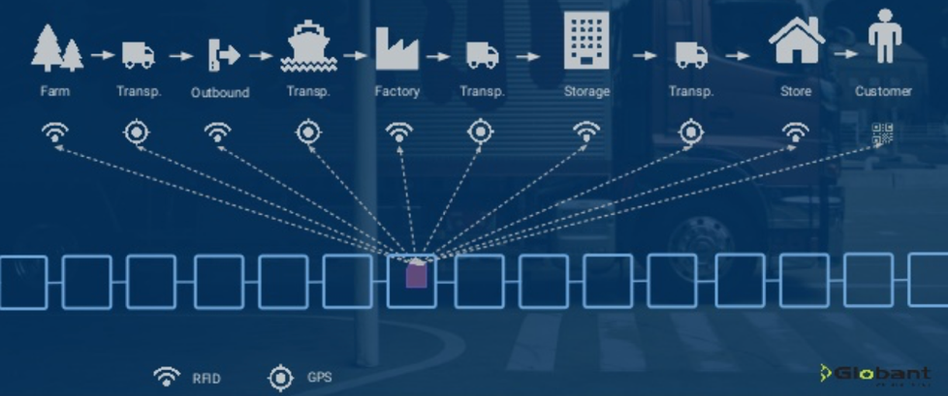
Blockchain：A Transparent Database with measurable trust-worthiness
sign
chain
Blockchain uses a 256 bit wide account format：2²⁵⁶=10⁷⁷=10⁵⁰*10²⁷
Due to its large account name space (10⁷⁷),
one may freely assign account to any thing and any time

Slide 6
数字资产可被打包为通证化货币
Blockchain uses a 256 bit wide account format：2²⁵⁶=10⁷⁷=10⁵⁰*10²⁷
The Blakcbox of
Information
System

Slide 7
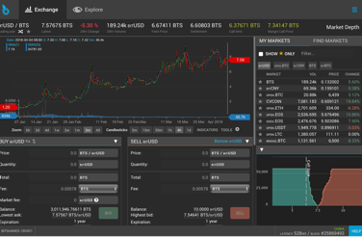
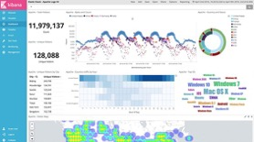
All Digital Assets can be labeled as Token
Blockchain uses a 256 bit wide account format：2²⁵⁶=10⁷⁷=10⁵⁰*10²⁷
The Blakcbox of
Information
System
Content Data
All Labeled Data
can be traded
Labeled Content Data
Is Searchable
Software Components
Can be Re-Combined
Software Data
Docker uses bit-string
to label Software Data
Data services
can be deployed globally
Configuration Data
Backup and Restore
Automation Service

Slide 8
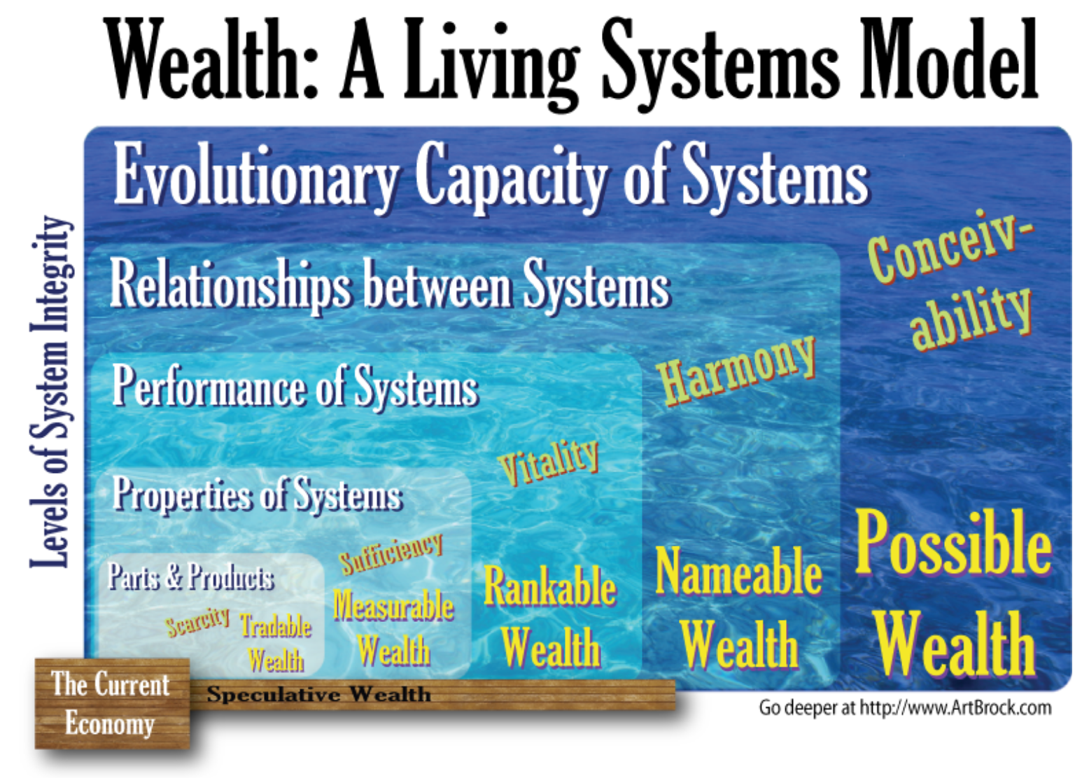
Arthur Brock’s Living Systems Model
Notes:
Welcome. My web site is a catch-all for the strange projects and activities that I’m involved in. Friends who know I’m not good about sending correspondence or newsletters have encouraged me to provide a central place to keep up.
The truth is that since my first web site in 1995, I really haven’t been reliable for posting much about myself. Now I’m being poked, prodded and supported in doing so. So I hope to do better.
I spend most of my time and energy on projects that I believe support and accelerate the harmonious evolution of humanity. We live in strange and miraculous times. Rapid transition and transformation surround us, but the outcomes of these transitions are still uncertain. I believe that humanity has much greater capacities than we currently employ. I am working to unleash those capacities for the mutual benefit of all.
You can find out more about me on the bottom of this page or learn about projects old and new. I’m also trying to include regular media from my activities on the “go deeper” page.
Emerging Leader Labs - Seed Project
I really haven't had a chance to update my web site with any information about my most recent life-consuming project: Emerging Leader Labs. We're creating a template for social impact incubators to flourish outside of the monetary economy.
One of our participants captured the spirit of the project pretty darn well in this new video he just made. Yay Ben!
A Living Systems Model of Wealth
Money is a terrible measure of value. In the same way that most of the value you have to offer, is simply not accessible through dollars, our economy fails to access and enable the bulk of the value around us. Until we create currencies which recognize value flows at all these levels, we perpetuate intolerable poverty. This isn't a poverty of inequitable distribution, but a poverty of measurement.

